Slide 1
Getting Started With AngularJS
View AngularJS course details at www.edureka.co/angular-js

Slide 2





What will you learn today?
Why should we use AngularJS?
What is AngularJS?
Big Brands Using AngularJS
AngularJS Features
AngularJS MVC & MVW Architecture
Basic AngularJS Program
Directives and Filters
What is Single Page Application?
How to Build a Responsive Single Page Application?

Slide 3

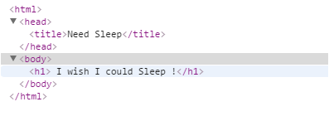
A Web Page
Web Page
html
HTML Markup
head
body
title
h1
DOM Tree of the HTML document

Slide 4
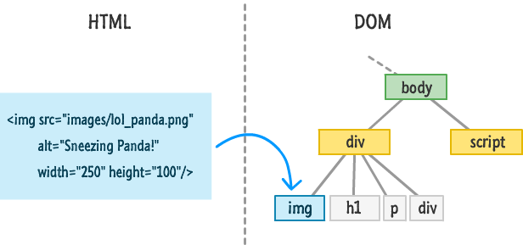
What the heck is DOM ?
DOM is a structured representation of a document and it provides a programming interface which allows you to change the style and content of the web page

Slide 5

Deep Thought …
So it means If I can manipulate the DOM, I would be able to change page content, but how would I do that ?

Slide 6
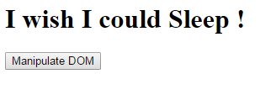
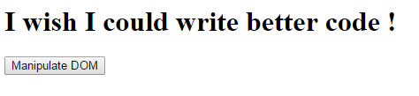
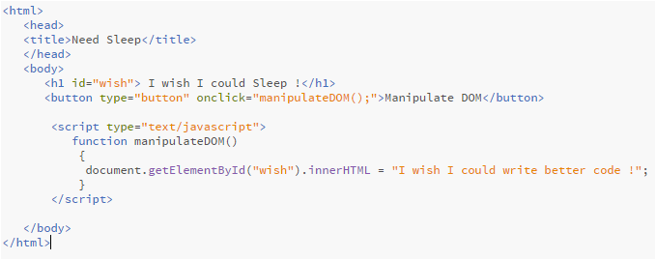
Traditional Way of Manipulating DOM - JavaScript
on clicking Manipulate DOM button
Manipulating DOM (webpage) with JavaScript

Slide 7
Deep Thought …
I remember jQuery can do DOM manipulation pretty easily !

Slide 8
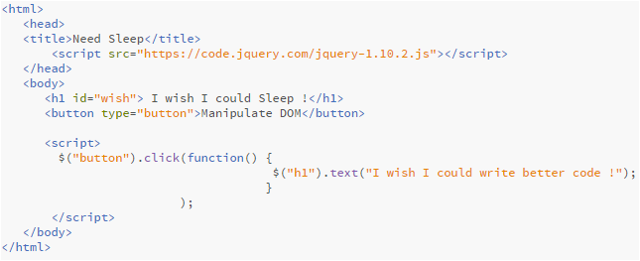
Traditional Way of Manipulating DOM - jQuery
on clicking Manipulate DOM button
Manipulating DOM (webpage) with jQuery

Slide 9
Manipulating DOM - AngularJS
Traditionally, the view modifies the DOM to present data and manipulates the DOM (or invokes jQuery) to add behavior
AngularJS puts all the DOM manipulation code into directives, thus easily separating that code out from the view and making it available as standalone reusable units
This helps the UI developer to concentrate fully on the user interface and the application developer to work separately on DOM manipulations and JQuery calls.
whereas…

Slide 10
AngularJS Way
HTML
Browser
AngularJS
Static
DOM
DOM Content Loaded Event
ng-app=“application name”
$injector
$compile
$rootscope
Dynamic
DOM (view)
$compile(dom, $rootscope)

Slide 11
AngularJS Way
Web App URI request is made
If changes to the model are found, Angular updates the affected bindings within the view
Angular.js is Downloaded
When an event occurs, Angular checks for a change to the model
Bootstrap callback is registered by AngularJS
Once bootstrapped, Angular waits for browser events that might change the model
HTML page is fully downloaded and callback is executed
Angular compiles the DOM by starting at the ng-app root, then processes directives and bindings as it work its way down the tree
Angular traverses the DOM tree to find ng-app directive
Angular locates the element containing ng-app directive and defines it as the root of app DOM
Dependency Injection is created by an Injector
Injector creates the root scope object ($rootScope) that will become the context for app’s model

Slide 12
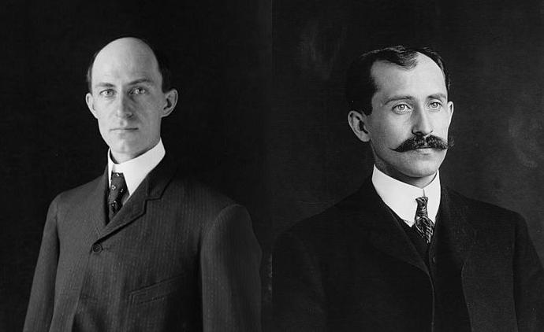




Can you guess, Who invented AngularJS ?

Slide 13

AngularJS Inventors
AngularJS was originally developed in 2009 by Misko Hevery and Adam Abrons at Brat Tech LLC, firstly named as GetAngular
<html> enhanced for web applications

Slide 14







Big Brands Using AngularJS
YouTube application for Sony's PlayStation 3
Go To : www.madewithangular.com

Slide 15
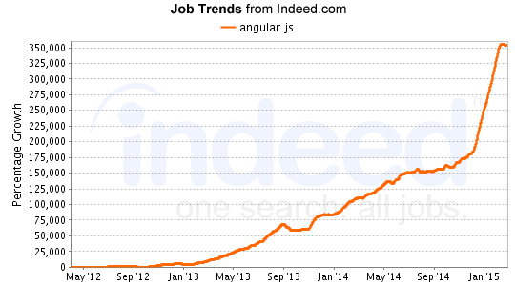
Hence The Growth In Job Trends

Slide 16
AngularJS Features

Slide 17
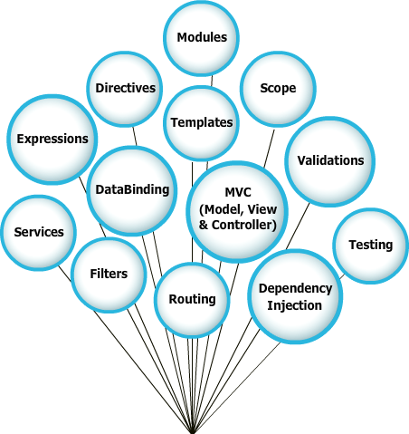
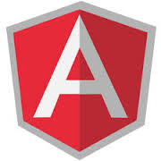
Features of AngularJS

Slide 18
MVC & MVW

Slide 19

MVC & MVW Way of AngularJS
MVC
MVW
Model
View
Model
View
HTML
HTML
CSS
CSS
2 way data binding
2 way data binding
Whatever
Controller
JavaScript
Controller
Directive
Unit Test
Services

Slide 20
AngularJS First Program

Slide 21
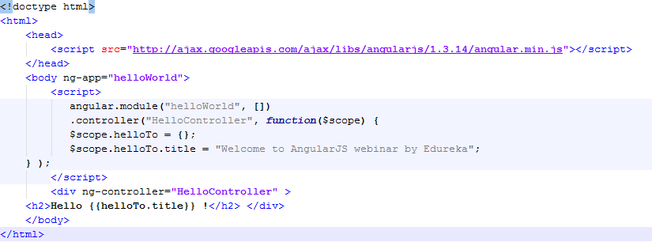
AngularJS: Your First Program
Steps to create an AngularJS Application
Include AngularJS

Slide 22
AngularJS: Your First Program
Steps to create an AngularJS Application
2. Bootstrap the App

Slide 23
AngularJS: Your First Program
Steps to create an AngularJS Application
3. Create the Controller

Slide 24
AngularJS: Your First Program
Steps to create an AngularJS Application
4. Create the View

Slide 25
AngularJS Directives
The process of rendering of HTML inside the AngularJS application are controlled by Directives
Directives guide the HTML compiler to control the DOM elements by attaching specific behavior to the elements
Directive
Directive

Slide 26
Built in Directives
Name | Description
ngJq | Use this directive to force the angular.element library. This should be used to force either Jqlite by leaving ng-jq blank or setting the name of the jQuery variable under window (eg. jQuery)
ngApp | Use this directive to auto-bootstrap an AngularJS application. The ngApp directive designates the root elementof the application and is typically placed near the root element of the page - e.g. on the <body> or <html> tags
a | Modifies the default behavior of the html A tag so that the default action is prevented when the href attribute is empty
ngDisabled | This directive sets the disabled attribute on the element if the expression inside ngDisabled evaluates to truthy
form | Directive that instantiates FormController
ngClass | The ngClass directive allows you to dynamically set CSS classes on an HTML element by databinding an expression that represents all classes to be added
ngController | The ngController directive attaches a controller class to the view. This is a key aspect of how angular supports the principles behind the Model-View-Controller design pattern
For rest of the directives refer https://docs.angularjs.org/api/ng/directive

Slide 27
AngularJS Filters
It formats the value of an expression for display to the user
Filters in view templates can be used with the following syntax
{{ expression | filter }}
Filters are generally injected when used with controllers, services and directives
With filters data can be organized to meet certain criteria
UpperCase
LowerCase
Currency
{{entity.name() | uppercase}}
{{entity.name() | lowercase}}
{{entity.amount() | currency}}

Slide 28
Filter Types
Generally used filter types
Name | Usage
uppercase | Change case of string to uppercase
lowercase | Change case of string to lowercase
currency | Formats string to currency format
number | Formats numerical value
json | Json representation
date | Formats date
filter | Filters array based on criteria
orderBy | Orders array based in criteria
limitTo | Limits number of objects

Slide 29
Single Page Application
Single-Page Applications (SPAs) are Web apps that load a single HTML page and dynamically update that page as the user interacts with the app
In a Single Page Application or SPA the page never reloads, though parts of the page may refresh. This reduces the round trips to the server to a minimum
Client Side Routing
Client Side Rendering

Slide 30
How To Build Responsive SPA Using AngularJS ?

Slide 31
Building Highly Responsive Single Page Application
Usecase : Build a User Management Application
Prerequisite :
Text Editor (sublime or notepadd ++)
Latest browser (Firefox or Chrome)
Installed NodeJS (server)
Mongo (To store userinfo)
Project Specifications :
Login to the Application
Create a new user
View Users List
Update a existing user
Delete user
Signout

Slide 32

Certifications
Get certified in AngularJS by Edureka
Go to www.edureka.co/angular-js
Batch starts from 24th October (Weekend)
Edureka's AngularJS course:
It covers the fundamental concepts like directives, routes, filters, services and factors which helps to build rich user interface web applications in AngularJS.
It helps you boost your web development skills and become a sought after SPA (single page application) developer. You will learn the highly efficient Angular features like data binding, scope management, form validation, routing, i18n & lot more.
Get to work on a To-Do List App Project towards the end of the course, which gives you complete insights on the Node.js framework.
Online Live Courses: 21 hours
Assignments: 20 hours
Project: 20 hours
Lifetime Access + 24 X 7 Support

Slide 33
Thank You
Questions/Queries/Feedback
Recording and presentation will be made available to you within 24 hours

